Slide 1
Test Approach for eBay Page
Swati Sharma
V0.1
16 February 2018

Slide 2

Approach / Strategy
Behaviour Driven Development (BDD) framework has been used to test the eBay page
Cucumber is used as BDD tool with integration to Selenium and Java
BDD framework allows automation of functional validations in easily readable and understandable format to Business Analysts, Developers, Testers, etc.
Advantages
Automatically generate test code from "behaviour" description, eliminating the intermediate step of writing test code
This allows the direct execution of "behaviours" on application code

Slide 3

eBay Test Scenario Results:
7%
Passed Test Scenarios
93%
Failed Test Scenarios
Scenario001
Scenario Outline: Search and verify results
When I search for an item "<searchWord>"
Then I get a list of "<searchWord>" matching results
And the resulting items cards show: postage price, No of bids, price or show BuyItNow tag
Then I can sort the results by Lowest Price
And the results are listed in the page in the correct order
Then I can sort the results by Highest Price
X And the results are listed in the page in the correct order
Then I can filter the results by 'Buy it now'
And all the results shown in the page have the 'Buy it now' tag
Scenario002
Scenario: Search per category
When I enter a search term and select a specific Category
Then I get a list of matching results for Scenario Two
And I can verify that the results shown as per the selected category
Scenario003
Scenario: Search and navigate through results pages
When I search for an item
Then I get a list of matching results for Scenario Three
And the results show more than one page
Then the user can navigate through the pages to continue looking at the items
Screenshot/Example for this test scenario is attached on next slide

Slide 4
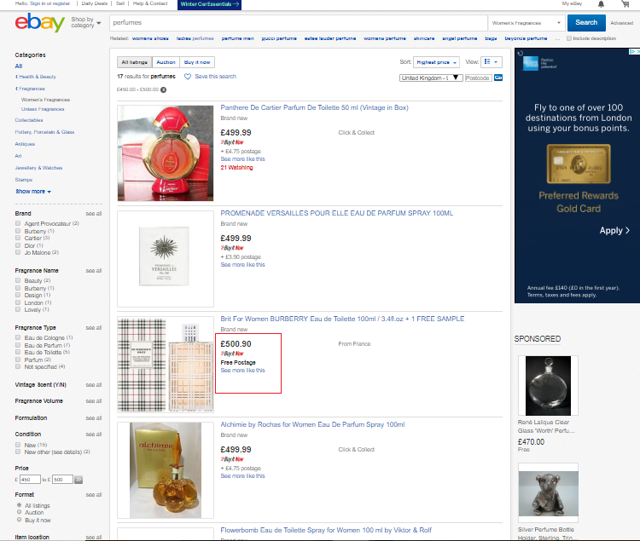
eBay Failure Test Scenario Example:
Sort of items is set as per ‘Highest price’
In correct scenario this item should have displayed before the top 2 items shown on page, but appearing in wrong order

Slide 5

Problem found in Existing Code Shared
Current shared code uses Cucumber-Java version 1.2.4. There is a known defect in this version of Cucumber with Java 8, which doesn’t allow your code to run and gives java.lang.IllegalArgumentException exception.
Reason for Error:
The problem is caused because the Java8 dialect of Cucumber uses implementation details of Oracle's JDK8.
Solution:
Issue solved in the next release of Cucumber version 1.2.5. This assignment code is also making use of this version to proceed with the test cases, accordingly pom.xml has been modified.
References:
GitHub page - https://github.com/cucumber/cucumber-jvm/issues/912
Stackoverflow - https://stackoverflow.com/questions/32728342/always-getting-exception-wrong-type-at-constant-pool-index-with-cucumber-java8

Slide 6
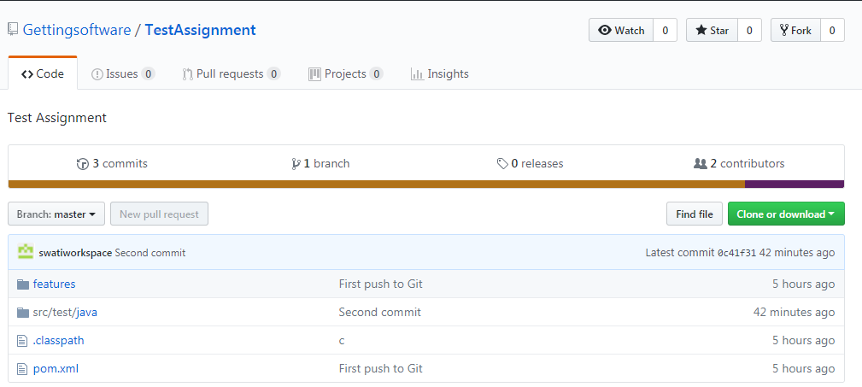
Assignment Code on GitHub:
Repository Location: https://github.com/Gettingsoftware/TestAssignment
Consists of Cucumber feature file covering all Scenarios
Consists of:
Utilities files – like Web Connector & Browser control
Test Runner class where Hooks are defined
Step Definition class file
Project Object Model file with all dependencies, where Cucumber version is modified and updated to 1.2.5

Slide 7
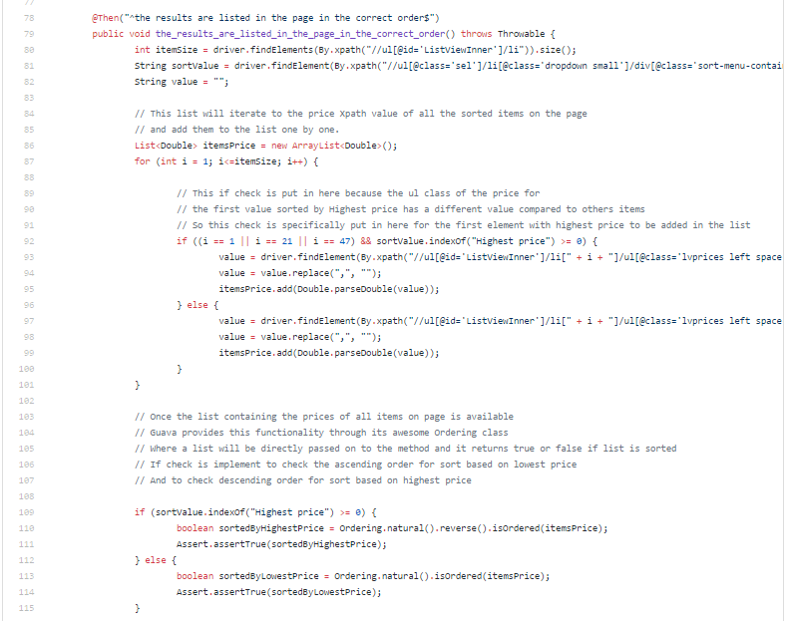
Step Definition Class – Method to be Noted:
File Location: https://github.com/Gettingsoftware/TestAssignment/blob/master/src/test/java/ebay/qa/testautomation/EbayHomePageStepDefinition.java
This if condition is put in here because for some items sorted by Highest order, have different Xpath values compared to generic path.
Once all displayed items are added to the list, Guava library from Google will be used to check the Sorting order of the list.

Slide 8

Thank You

